Slide 1

Data analysis on Vanguard AB testing
Week 5-6 ~ Andor, António, Valter

Slide 2

Vanguard - Democratizing wealth management
Vanguard is an investment management company known for its low-cost index funds and exchange-traded funds (ETFs), helping individuals and institutions build wealth through diversified portfolios.
We believed that a more intuitive and modern User Interface (UI), could make the online process smoother for clients.
To test the performance or our new UI, we have conducted an AB test on a heterogeneous population divided in 2 groups (Test and Control group) and check the efficacy of the new interface.

Slide 3

Data manipulation
The research has been driven on a corpus of three datasets (Anagraphics, digital footprints and experiment roster)
The datasets have been merged together to calculate and display relevant datas, such as time of completion per group, completion rate and error rate (defining as “error” all attempts of a number of steps different than 5.
Probability tests have been performed to measure the reliability of the used sample - as some incomplete entries have been detected and discarded from the population.

Slide 4

Performance metrics
The KPI we considered for the testing were:
COMPLETION RATE - rate of attempts with a positive outcome per group DURATION - time from the first to the last step attempted by a client ERROR RATE - rate of attempts whose number of steps differs from 5
Moreover, some anagraphics have been collected to analyze the groups and verify their heterogeneity and avoid possible bias.

Slide 5

Anagraphics
Gender-wise, the two groups present an equal distribution: TEST GROUP: 8977 Men, 8716 Women, 9266 Unspecified gender CONTROL GROUP: 7970 Men, 7542 Women, 8014 Unspecified gender
Age-wise, the two group both comprehend a range of people from 17 to 96
Balance-wise, the average of both groups does not significantly differ: TEST GROUP: 148962.6 CONTROL GROUP: 150151.9
Tenure-wise, the average years of tenure of both groups are also similar: TEST GROUP: 11,98 years CONTROL GROUP: 12.08 years

Slide 6

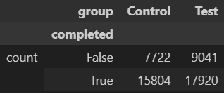
KPI-based results - Completion rate
The results of the investigation show a slight increase of completed attempts for the test group.
Proportionality has to be considered, as the test group has a significantly higher number of attempts.
The χ² test indicates a p-value of 0.0927, so the hypothesis of no relation between group and completion cannot be rejected, suggesting no significant association between the two variables.

Slide 7

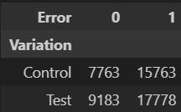
KPI-based results - Error rate
The results of the investigation show a proportional similarity of errors between the two groups.
The Cramér’s V test shows a very weak (0.011) association between group and error variables, labeling the variables as nearly independent.
The χ² test indicates a p-value of 0.0119, so the hypothesis of no relation between group and error is rejected, implying an association between the variables.

Slide 8

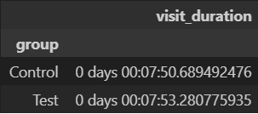
KPI-based results - Duration
The results of the investigation show no significative variation between both group durations.
The T-test indicates a very high p-value of 0.99994, portraying no statistical difference between groups at the 5% level of significance.

Slide 9

Teamwork and project management
All members of the team have preferred a more autonomous yet coordinated approach to the project, as each one has picked a task and merged it with the others’.
The data manipulation has been performed on each notebook, and then compared and summarized for data visualization.
The main challenges lodge in the nature of this organization, as more autonomy increases the range of initiative, with a wider risk of inconsistency as a possible consequence.

Slide 10

Thanks for your attention!

